Slide 1
Current challenges of interconnected transmission systems - decarbonisation and Green Deal
Miroslav Vrba
Association of Energy Managers

Slide 2
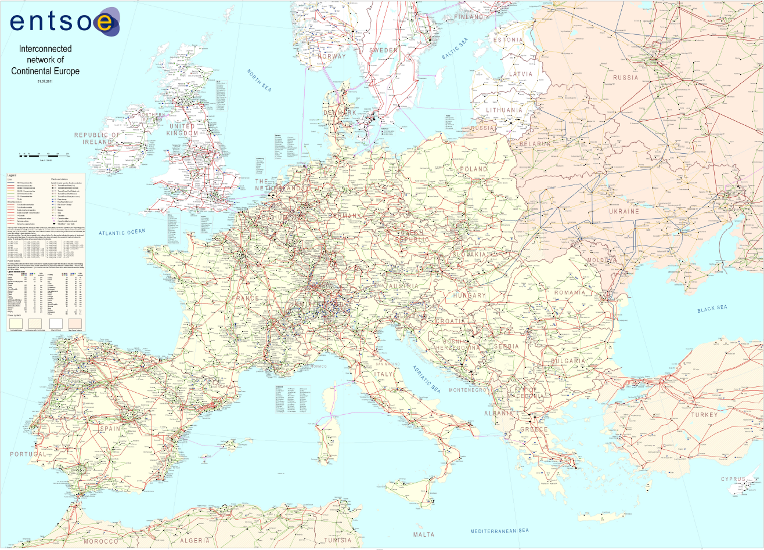
Interconnected European meshed grid an advantage or threat?

Slide 3
What is transmission system?

Slide 4
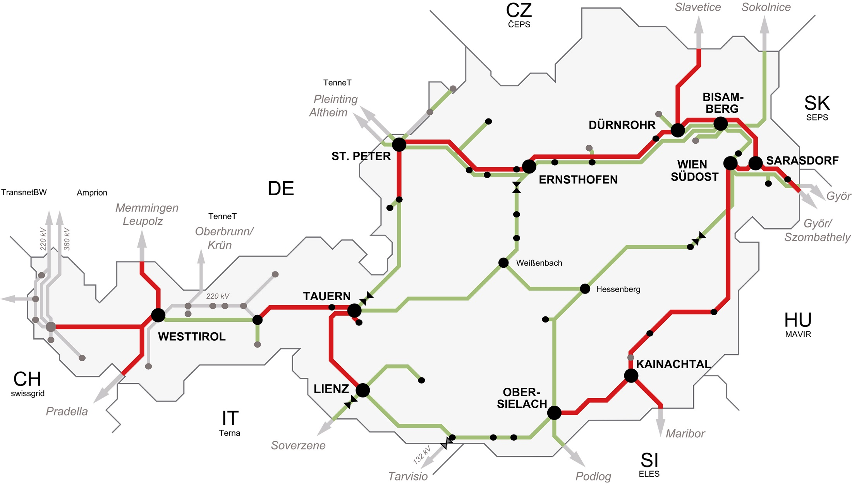
Austrian transmission power grid

Slide 5
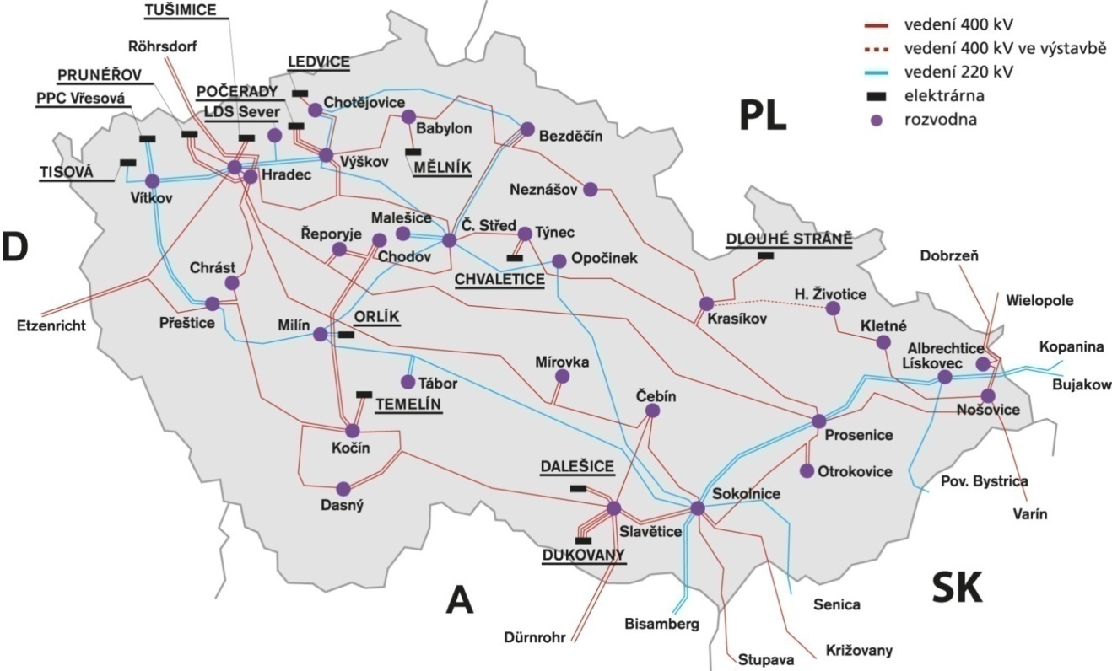
Czech transmission system

Slide 6
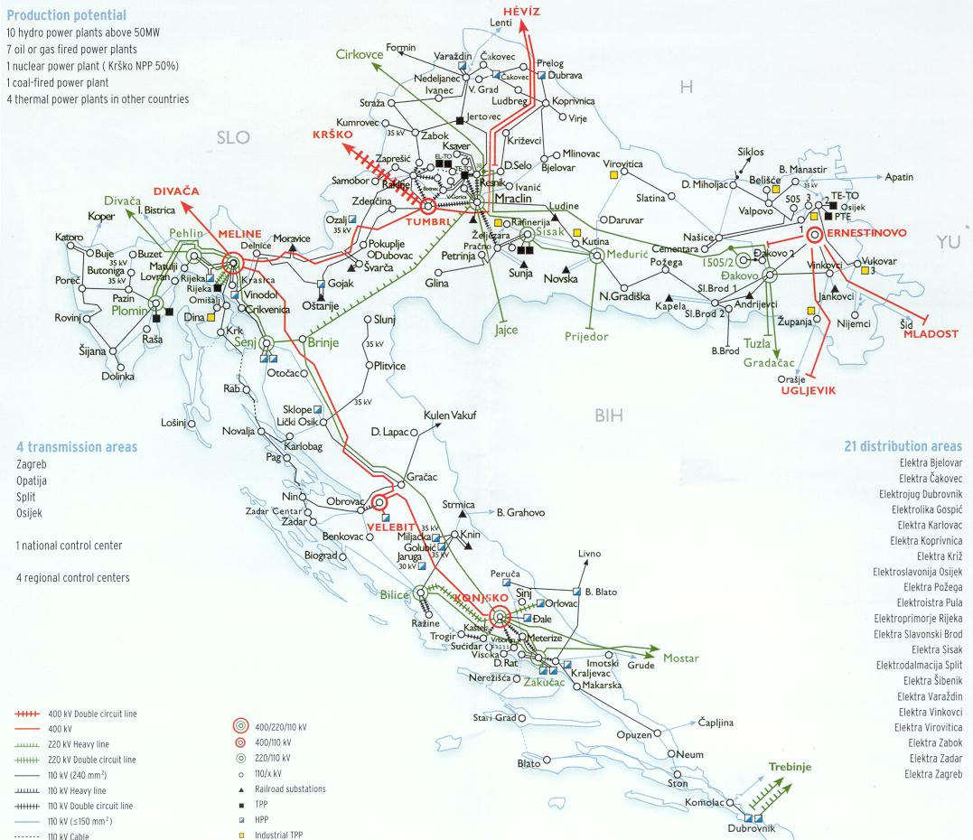
HOPS – Croatian transmission system

Slide 7
Continental Europe synchronous area separation on Friday, January 8th, 2021

Slide 8
System conditions before the separation
No unscheduled or forced outages of lines, substations, main generation units – in fact „full scheme“
Generating units were mainly conventional (coal-fired, nuclear, hydro), new renewables (wind, solar) injected less than 10% of total generation
Security procedures like Day-Ahead-Congestion-Forecast (DACF) or Intra-Day-Congestion-Forecast (IDCF) as well as in (n-1) simulations did not recognise any violations
Relatively warm weather on the east-south, cold (as usually in winter) on the north-west of the Europe
The Orthodox Christmas holiday on 6 and 7 January
Untypical export from east-south to north-west of the Europe 4400 MW
Relatively high imports of France, Italy and Spain (9100 MW)

Slide 9
What’s happen ?
In the substation Ernestinovo in Croatia power flow was increasing from 1700 A to 1900 A; after achieving 1990 A automatic protection tripped bus bar and overloaded transformers 400/110 kV
Power flows were searching other electrical ways, like the water in case of floods, in parallel lines from Balkan area to Nord-West Europe
Paradoxically, the best quality (low impedance), high capacity (power flow) highways were overloaded first, protection equipment tripped them and other lines (esp. 220 kV) were overloaded immediately
In 45 seconds the continental Europe was separated in two parts

Slide 10
Currents on transmission system elements in substation Ernestinovo before and after event

Slide 11
Frequency development during the event

Slide 12
Geographical location of main tripped elements

Slide 13
Defence actions
Automatic
  Frequency deviation detected and set automatically in the European Awareness System
  Activation of automatic frequency restoration reserves (primary reserve)
  Supportive interruptible load activation (load shedding)
Manual
  Start of gas and oil fast starting units
  Pushed up hydro power plants
  Support from other non-synchronised areas via HVDC links (Nordel, GB)
  Delay scheduled disconnection of some units
  Reduction of power generation on the South-East area
European Awareness System informed about the event all TSOs mutually
Communication of Coordination Centres and between TSOs
Frequency stabilisation and closing on 50 Hz
Resynchronisation

Slide 14
Automatic/contractual load shedding in France

Slide 15
Automatic/contractual load shedding in Italy

Slide 16
European Awareness System

Slide 17
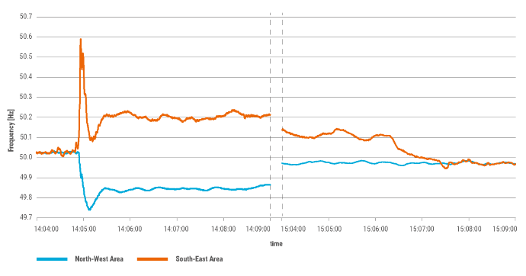
Frequency right after the disturbance and during resynchronisation

Slide 18
Next steps
Incident was classified as extensive according Incident Classification Scale methodology (0 - noteworthy, 1- significant, 2 – extensive, 3 – major)
A detailed report will be prepared by a panel of experts, comprised of:
  An analysis of causes of the incident
  An evaluation of activated remedial actions
  A description of the functioning of the network elements
  Recommendations based on the conclusions of the investigation

Slide 19
The European Green Deal

Slide 20
The European Green Deal and its impacts to power systems
Highlights
Supplying clean, affordable and secure energy
Decarbonisation of energy systems
A power sector must be developed that is based largely on renewable sources, complemented by the rapid phasing out of coal and decarbonising gas
Decarbonisation of the transport sector
etc.

Slide 21
Tools and technologies of the Green Deal for energy sectors
National Energy and Climate Plans
Energy markets re-design
Just transition mechanism
Off-shore renewables
  Wind parks
  Tidal and wave convertors
Solar photovoltaics
Energy efficiency
Renewable hydrogen production and consumption
Energy storage
Smart grids
Small modular reactors

Slide 22
Impacts of Green Deal to the power sector
Coal-fired power plants incl. co-generating units phase-out
Natural gas fired units phase-out
E-mobility will replace oil-based mobility
Hydrogen and other syn-gases will replace natural gas and crude-oil products
less electricity resources, more demand

Slide 23
Fossil and non-fossil electricity generation

Slide 24
Current challenges of interconnected transmission systems - decarbonisation and Green Deal
Miroslav Vrba
Association of Energy Managers

